Slide 1
Machine Learning
Paired Sampled t-test
and
Independent Sampled t-test
CS 3104 Fall 2019
Slides taken from t-test ppt by Arlo Clark-Foos

Slide 2
Learning Objectives
After completion of today’s session you will be able to:
Implement Paired Sampled t-test.
Implement Independent Sampled t-test.

Slide 3
Paired Samples t Test
Two Related (dependent) samples

Slide 4
Paired-Samples t Test
Used to compare 2 means for a within-groups design, a situation in which every participant is in both samples (paired/dependent)
New Terminology
Distribution of Mean Differences
Difference Scores: X₁ – Y₁, X₂ – Y₂, …
Let’s walk through an example…

Slide 5

Six Steps for Hypothesis Testing
1. Identify
2. State the hypotheses
3. Characteristics of the comparison distribution
4. Critical values
5. Calculate
6. Decide
old hat

Slide 6
Paired Samples t Test: Does Studying in the Exam Room Help?
A research was conducted about effects in studying for exams by a group of students in the same or different rooms. It was to analyze that the approach is hurting or helping students. A group of 5 participants complete two highly similar machine learning exams. First these participants studied for and completed the exams in the same room later in different rooms, order counterbalanced*. Data for SAME and DIFFERENT rooms are:
Difference Score X-Y
-11
-15
-14
-4
-11
SAME (X) | DIFFERENT (Y)
122 | 111
131 | 116
127 | 113
123 | 119
132 | 121
M = -11

Slide 7
Paired Samples t Test: Does Studying in the Exam Room Help?
Identify
Populations:
Pop 1: Exam grades when studying and testing are in the same room.
Pop 2: Exam grades when studying and testing are in different rooms.
Distribution:
Mean of Difference Scores: Distribution of Mean Differences
Test & Assumptions: One group of participants that is studied at two time points, paired-samples t test
Data are interval
Probably not random selection
Sample size of 5 is less than 30, therefore distribution might not be normal

Slide 8
Paired Samples t Test: Does Studying in the Exam Room Help?
State the null and research hypotheses
H₀: Studying and testing in the same room will result in the same grade as studying and testing in different rooms.
H₁: Studying and testing in the same room will result in a different grade than studying and testing in different rooms.

Slide 9
Paired Samples t Test: Does Studying in the Exam Room Help?
Determine characteristics of comparison distribution (distribution of mean differences)
Population: μ_{M} = 0 (i.e., no mean difference)
Sample(s): M = -11, s = 4.301, s_{M} = 1.923
Difference Score X-Y
-11
-15
-14
-4
-11
M = -11
Deviation Score (Score - Mean)
0
-4
-3
7
0
Squared Deviation (Score - Mean)²
0
16
9
49
0
SS_{X} = 74

Slide 10
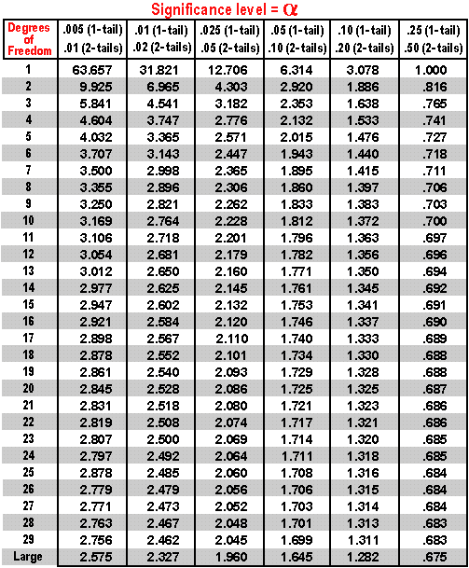
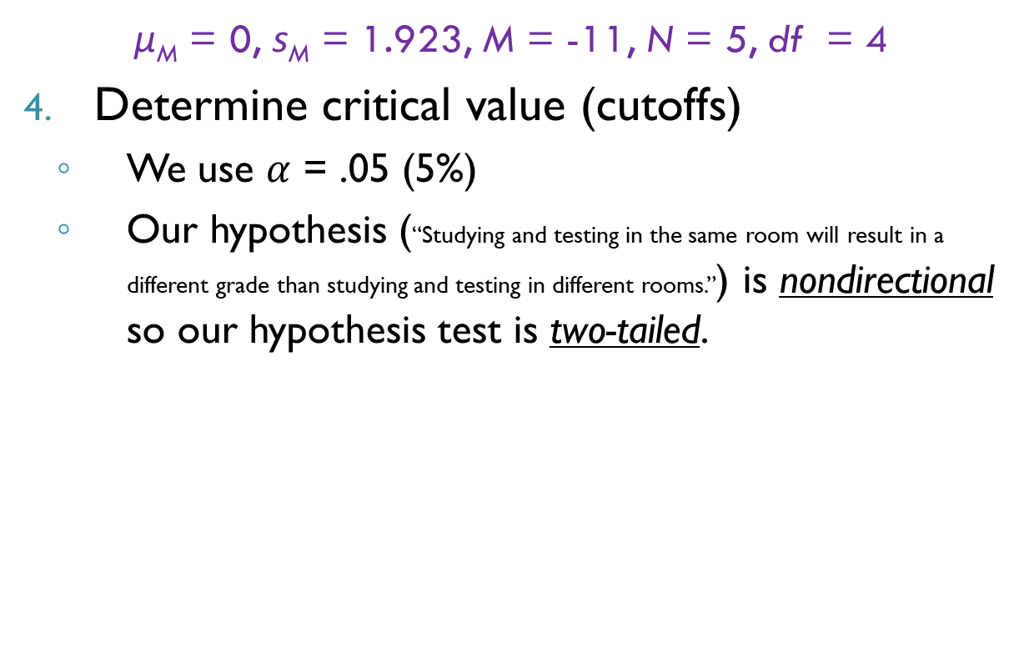
Paired Samples t Test: Does Studying in the Exam Room Help?
μ_{M} = 0, s_{M} = 1.923, M = -11, N = 5, df = 4
Determine critical value (cutoffs)
We use $α$ = .05 (5%)
Our hypothesis (“Studying and testing in the same room will result in a different grade than studying and testing in different rooms.”) is nondirectional so our hypothesis test is two-tailed.
df = 4

Slide 11
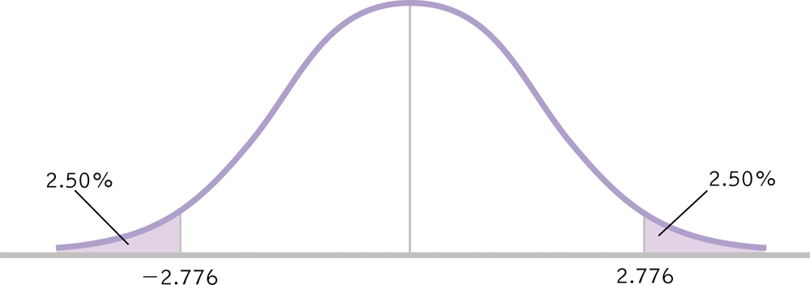
Paired Samples t Test: Does Studying in the Exam Room Help?
μ_{M} = 0, s_{M} = 1.923, M = -11, N = 5, df = 4
Determine critical value (cutoffs)
t_{crit} = ± 2.76

Slide 12
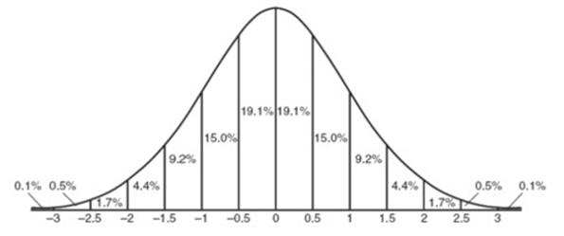
Paired Samples t Test: Does Studying in the Exam Room Help?
μ_{M} = 0, s_{M} = 1.923, M = -11, N = 5, df = 4
Calculate the test statistic
Make a decision
-2.76
+2.76

Slide 13
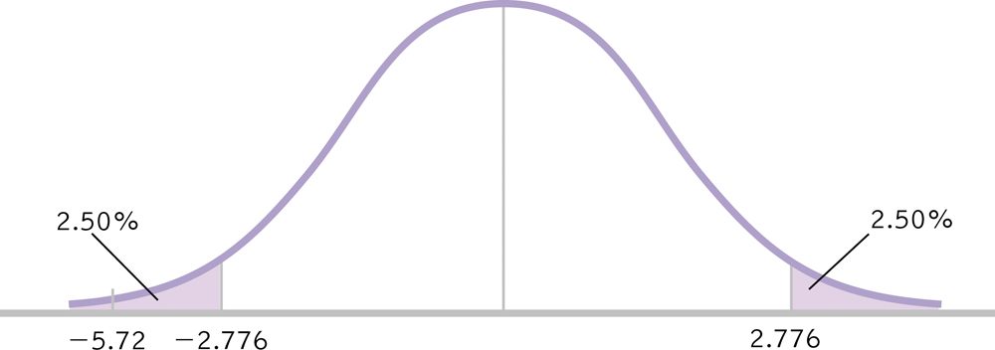
Paired Samples t Test: Does Studying in the Exam Room Help?
μ_{M} = 0, s_{M} = 1.923, M = 11, N = 5, df = 4
Make a decision
t = -5.720 > t_{crit} = ±2.776, reject the null hypothesis
People studying and testing in different rooms performed worse than … in the same rooms,
t(4) = 5.72, p < .05.

Slide 14
Independent Samples t Test
Two Unrelated (unpaired) samples

Slide 15
Independent Samples t Test
Used to compare 2 means for a between-groups design, a situation in which each participant is assigned to only one condition.
New Statistics & Terminology:
Distribution of Differences Between Means
df_{X} , df_{Y} , df_{Total}
Pooled Variance
Standard Error of the Difference

Slide 16
Six Steps for Hypothesis Testing
1. Identify
2. State the hypotheses
3. Characteristics of the comparison distribution
4. Critical values
5. Calculate
6. Decide

Slide 17
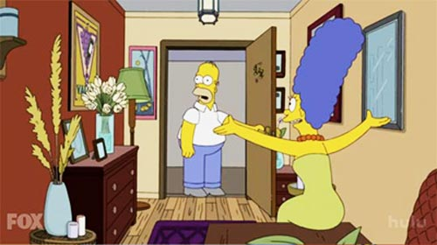
Independent Samples t Test: Gender Differences in Humor Appreciation
In this hypothetical study we ask: what percentage of cartoons do men and woman consider funny? 9 people were selected from the psychology subject pool and asked them to view a cartoon. After the cartoon, each participant gave a humor rating of the cartoon, from 0-100 (100 being the funniest possible). Here are those data.
Women (X) | Men (Y)
84 | 88
97 | 90
58 | 52
90 | 97
 | 86

Slide 18
Independent Samples t Test: Gender Differences in Humor Appreciation
Identify
Populations:
Pop 1: Women exposed to the cartoon
Pop 2: Men exposed to the cartoon
Distribution:
Difference Between Means: Distribution of Differences Between Means
Not Distribution of Mean Differences
Test & Assumptions: One group of participants that is studied at two time points, paired-samples t test
Data are interval
Random selection
Sample size of 9 is less than 30, therefore distribution might not be normal

Slide 19
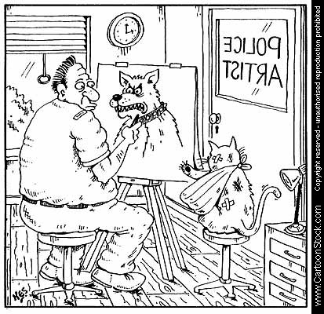
Independent Samples t Test: Gender Differences in Humor Appreciation
State the null and research hypotheses
H₀: Women will categorize the same number of cartoons as funny as will men.
H₁: Women will categorize a different number of cartoons funny than will men.

Slide 20
Independent Samples t Test: Gender Differences in Humor Appreciation
Determine characteristics of comparison distribution (distribution of differences between means)
Population: μ₁ = μ₂ (i.e., no difference between means)
????????

Slide 21
Independent Samples t Test: Gender Differences in Humor Appreciation
Determine characteristics of comparison distribution
S_{Difference}
Standard Error of the Difference:
Calculate variance for each sample
Pool variances, accounting for sample size
Convert from squared standard deviation to squared standard error
Add the two variances
Take square root to get estimated standard error for distribution of differences between means.

Slide 22
Calculating s_{Difference}
Calculate variance (s²) for each sample
Women (X) | X-M | (X-M)²
84 | 1.75 | 3.063
97 | 14.75 | 217.563
58 | -24.25 | 588.063
90 | 7.75 | 60.063
M_{X} = 82.25
SS_{X} = 868.752
Men (Y) | Y-M | (Y-M)²
88 | 5.4 | 29.16
90 | 11.4 | 129.96
52 | -30.6 | 936.36
97 | 14.4 | 207.36
86 | 3.4 | 11.56
M_{Y} = 82.6
SS_{Y} = 1314.4

Slide 23
Independent Samples t Test
df_{X} = N – 1 = 4 – 1 = 3
df_{X} = 3
df_{Y} = N – 1 = 5 – 1 = 4
df_{Y} = 4
df_{Total} = df_{X} + df_{Y} = 3 + 4 = 7
df_{Total} = 7
Women (X)
84
97
58
90
N = 4
Men (Y)
88
90
52
97
86
N = 5

Slide 24
Pooled Variance
Pool variances, accounting for sample size

Slide 25
Independent Samples t Test: Gender Differences in Humor Appreciation
Convert from squared standard deviation to squared standard error
Add the two variances
Take square root to get estimated standard error for distribution of differences between means.

Slide 26

Independent Samples t Test: Gender Differences in Humor Appreciation
Determine critical value (cutoffs)
We use $α$ = .05 (5%)
Our hypothesis (“Women will categorize a different number of cartoons funny than will men.”) is nondirectional so our hypothesis test is two-tailed.
t = ± 2.365
df_{Total} = 7

Slide 27
Independent Samples t Test: Gender Differences in Humor Appreciation
Determine critical values
df_{Total} = 7 p = .05 t = ± 2.365
Calculate a test statistic

Slide 28
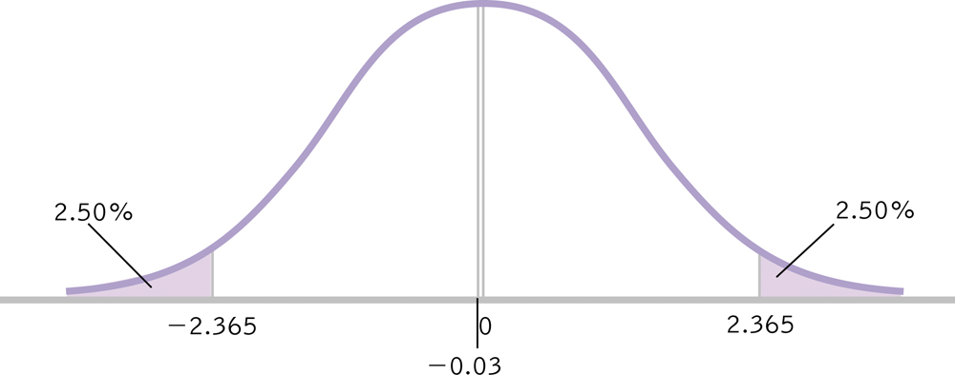
Independent Samples t Test: Gender Differences in Humor Appreciation
Make a decision
Fail to reject null hypothesis
Men and women find cartoons equally humorous, t(7) = .03, p > .05

Slide 29
Thanks

